Slide 1
Resume Classification Project - 602
Resume Classification using NLP & Machine Learning
Automated job-role prediction from resumes
Built using Python, NLP, ML, Streamlit
Mentor: Mr. Dilavar Basha
Team: Group 1
Dega Rambabu
Kurava Ravi Kumar
N.Sathasivam
Pavan Kumar

Slide 2
Problem Statement
Manual resume screening is slow and inconsistent
High volume makes human review inefficient
Project goal: Automate resume classification by job role

Slide 3
Project Objectives
Perform complete EDA on resume dataset
Extract & clean text from PDF/DOCX/DOC
Train and evaluate multiple ML models
Deploy best model via Streamlit

Slide 4
Dataset Overview
Dataset: resume_classification.zip
Each folder represents a job category
Files: PDF, DOC, DOCX formats
Extracted into a DataFrame with text + labels

Slide 5
Tools & Technologies
Python, Google Colab
Libraries: pandas, numpy, nltk, scikit-learn
PDF reading: PyPDF2, python-docx, textract
Deployment: Streamlit

Slide 6
Data Extraction Workflow
Upload zip file via files.upload()
Extract using zipfile
Iterate files with Path.rglob
Build DataFrame with filename, path, label, text

Slide 7
Handling Multiple File Formats
.docx → read with python-docx
.pdf → read with PyPDF2
.doc → converted using LibreOffice CLI
Skipped unreadable files

Slide 8
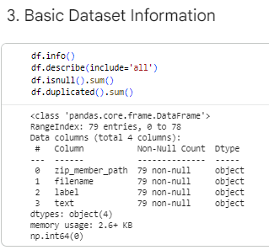
Master DataFrame Creation
Rows collected with filename, filepath, label, text
Converted to Pandas DataFrame
Skipped files logged for review
Ensured adequate data per label

Slide 9
Initial EDA Summary
Checked total resumes and skipped files
Observed label distribution
Found class imbalance in some categories
Verified text extracted successfully

Slide 10
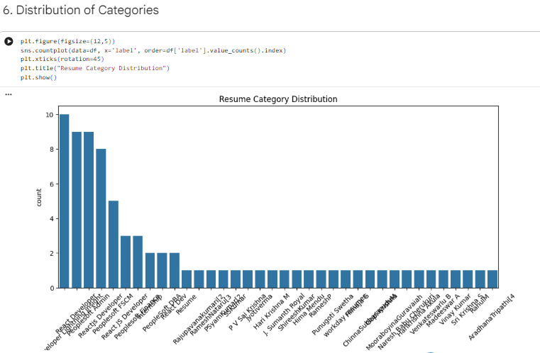
Label Distribution
Plotted count per job category
Observed imbalance
Macro F1 needed for fair evaluation

Slide 11
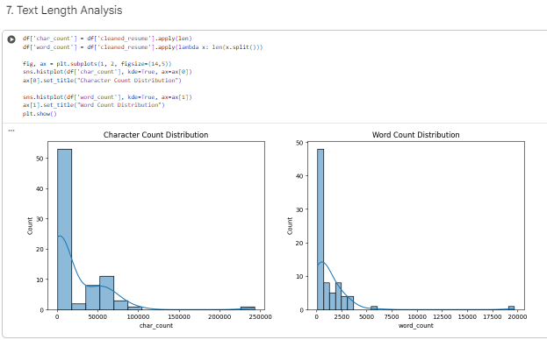
Text Length Analysis
Computed word/character counts
Plotted histogram of word distribution
Found typical resume lengths
Identified outliers (too short)

Slide 12
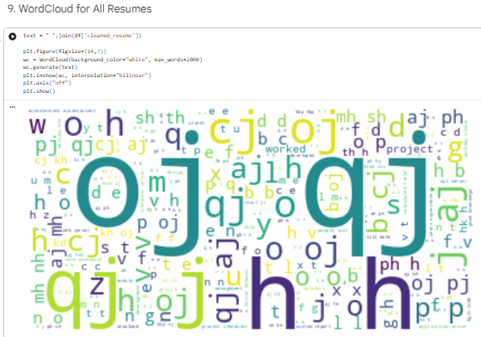
Text Cleaning Steps
Lowercasing text
Removing URLs, special characters, mentions
Whitespace normalization
Stored as cleantext

Slide 13
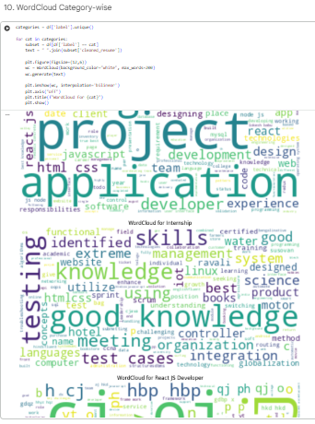
Stopword Removal
Used NLTK stopwords
Tokenized text
Removed common English stopwords
Created alternative column clean-text nostop

Slide 14
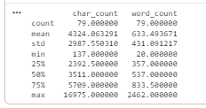
Feature Selection
X = cleaned text
y = job category
Prepared dataset for ML pipeline
Checked missing values, sanity checks
Clean text and create features useful for EDA and modeling

Slide 15
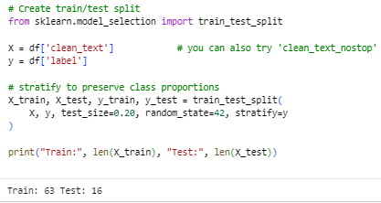
Train-Test Split
Used 80/20 split
Stratified by labels
Random state = 42
Ensured representative distribution

Slide 16
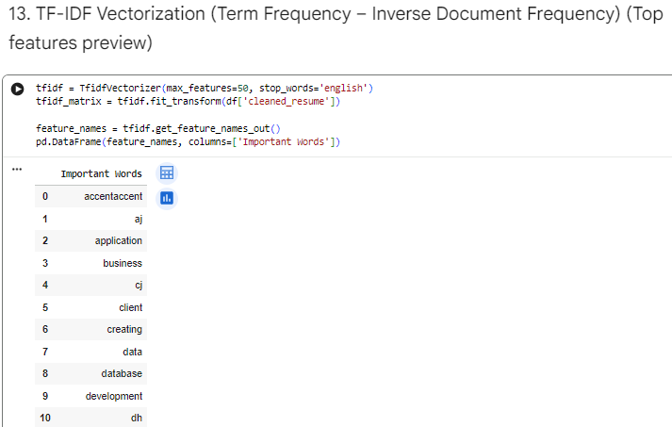
TF-IDF Vectorization
Used bigrams + unigrams
ngram_range = (1,2)
max_df = 0.95, min_df = 2
Vocabulary limited to 15,000 features

Slide 17
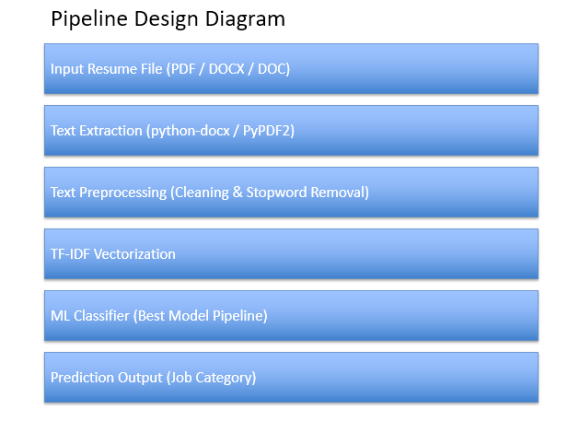
Pipeline Design
Scikit-learn Pipeline used
Includes TF-IDF + classifier
Ensures easy deployment and saving
Applied same preprocessing during inference

Slide 18
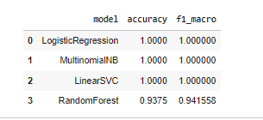
Models Evaluated
Logistic Regression
Multinomial Naive Bayes
Linear SVC
Random Forest
All trained with same TF-IDF features

Slide 19
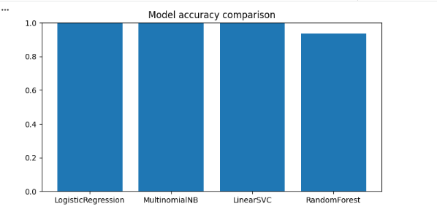
Evaluation Metrics Used
Accuracy Score
Macro F1-score (due to class imbalance)
Classification Report
Confusion Matrix

Slide 20
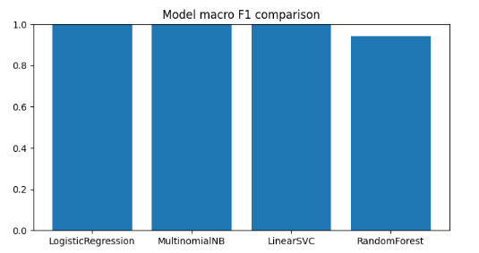
Model Comparison Results
Results stored in res_df
Sorted by macro F1
Visualized with bar plots
Identified top-performing model

Slide 21
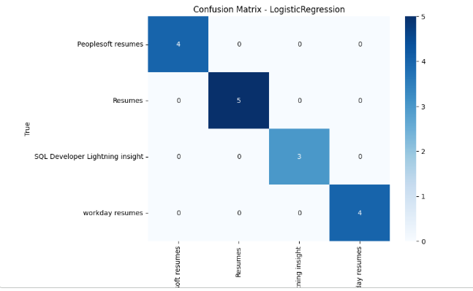
Confusion Matrix Insights
Plotted using seaborn heatmap
Identified misclassified categories
Highlighted overlapping roles
Used insights for improvement

Slide 22
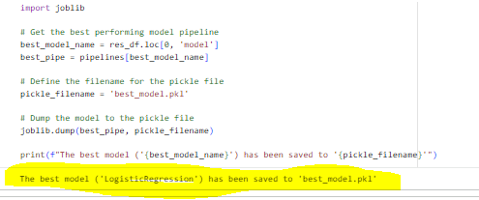
Best Model Selection
Best model selected using Macro F1
Commonly Linear SVC or Logistic Regression
Extracted best pipeline
Prepared for saving

Slide 23
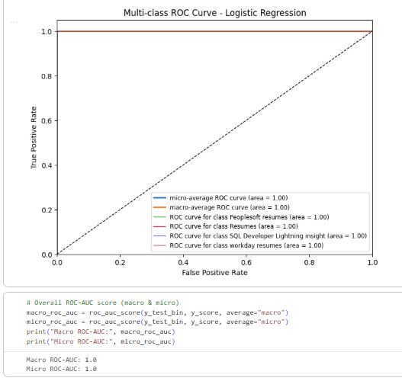
Multi-class ROC curve for Logistic Regression
We plotted multi-class ROC curves using a one-vs-rest strategy for the Logistic Regression model, computing ROC and AUC for each class as well as micro- and macro-average ROC. The macro ROC-AUC score was approximately 1.00, indicating strong discriminative performance across categories.

Slide 24
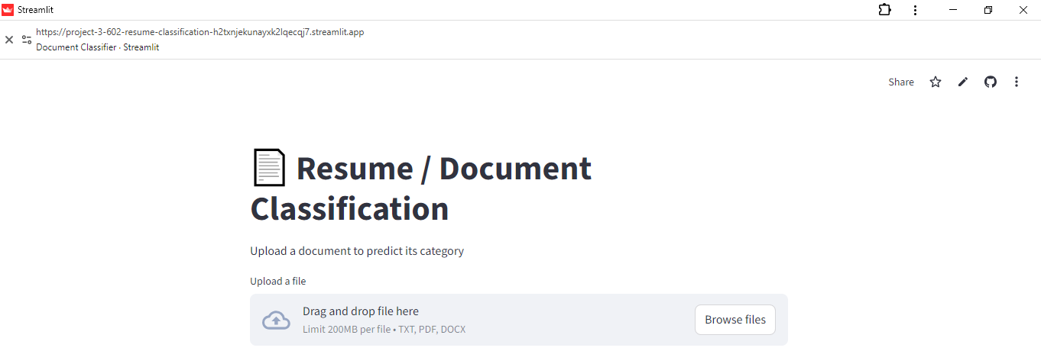
Streamlit App Overview
app.py loads best_model.pkl
User uploads resume file
Performs text extraction + preprocessing
Predicts and displays job category

Slide 25
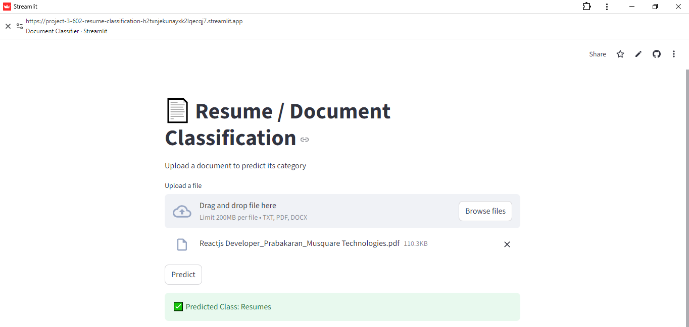
Streamlit Workflow
Upload → Extract → Clean → Predict
Supports PDF/DOCX/TXT
Displays prediction and optional confidence
Simple & user-friendly UI

Slide 26
Challenges Faced
Handling PDF/DOC/DOCX extraction issues
Empty or poorly scanned PDFs
Environment dependency conflicts
Class imbalance affecting evaluation

Slide 27
Conclusion
Successfully automated resume classification
NLP + ML pipeline built end-to-end
Multiple models trained and compared
Deployed best model with Streamlit

Slide 28
Key Takeaways & Future Enhancements
Importance of text preprocessing
Pipeline simplifies production use
Future: Try BERT embeddings
Add explainability & bulk prediction support

Slide 29

THANK YOU

